Slide 1
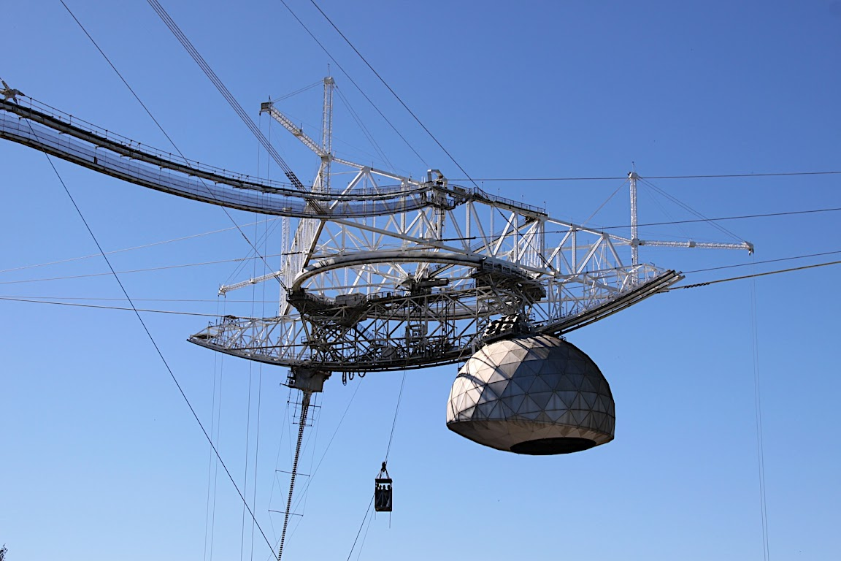

Slide 2
Student exercise/competition

Slide 3
Tomorrow:
All talks in by 8:45!
Group presentation ~15 min per group
Order selected on the spot
Everyone have to participate (present something)
Please fill in the evaluation form before you leave!

